Slide 1


CI/CD Assignment
Presented By: Lokesh Kumar
Notes:
Note: First “Right Click” on the Gradient background, go to “Order” option and “Send it to Back”, then insert your picture into “Image Placeholder”, “Right Click” on the picture and again go to “Order” option and “Send it to Back” to get the “Gradient” effect.

Slide 2

Agenda
Create a Jenkins pipeline to deploy application present at: https://github.com/knoldus/node-hello
Required command to run the application and the ports being used are present in the Github repository.
You are required to use Jenkins Freestyle project to set this pipeline.
Requirements:
Jenkins should be set up on a Cloud Virtual Machine and not from the local system
Any commits to the ‘main’ branch should trigger the job on Jenkins and start the build process
Use Poll SCM triggers
The first part of the Jenkins job should be creating the package
The second part of the Jenkins job will be to send the package to another VM and run it there
The validations can be performed by hitting endpoints: <VM_IP>:3000 or <VM_IP>:3001

Slide 3
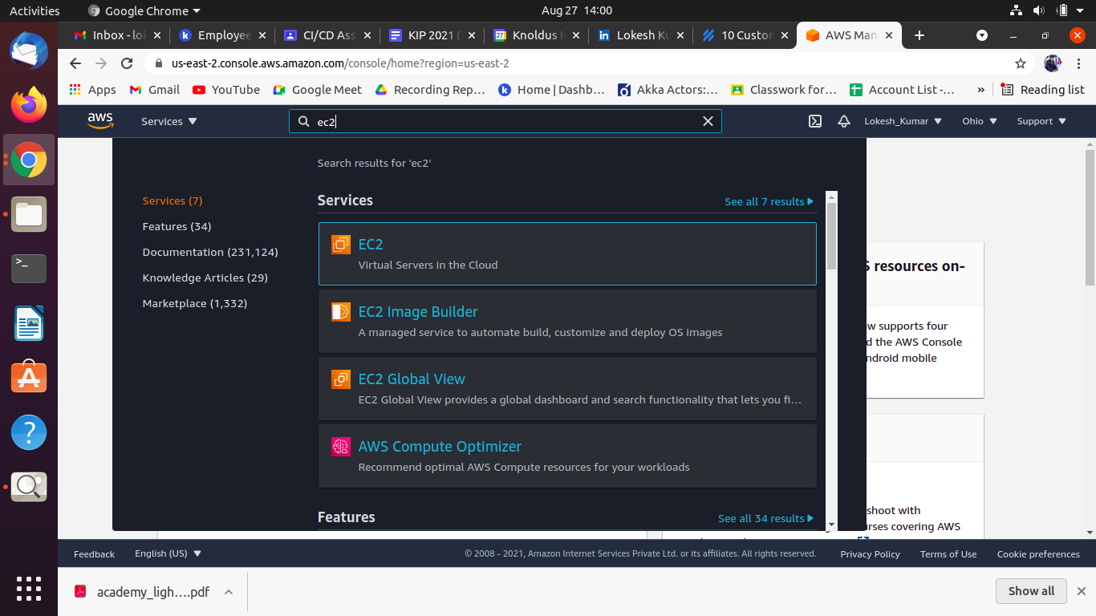
Step 1: Create an Instance on AWS

Slide 4
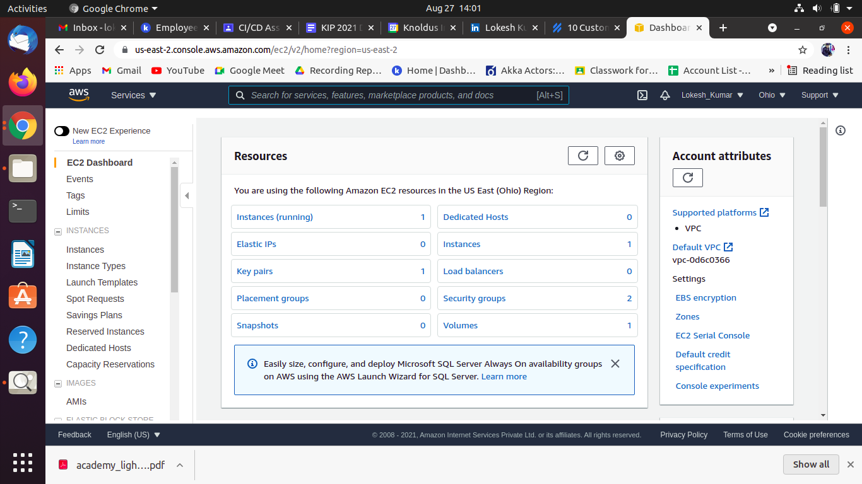

Slide 5
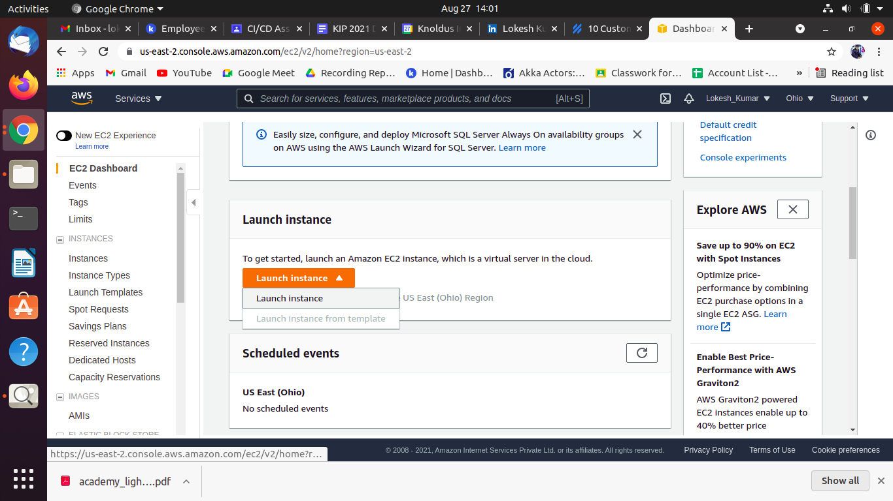

Slide 6
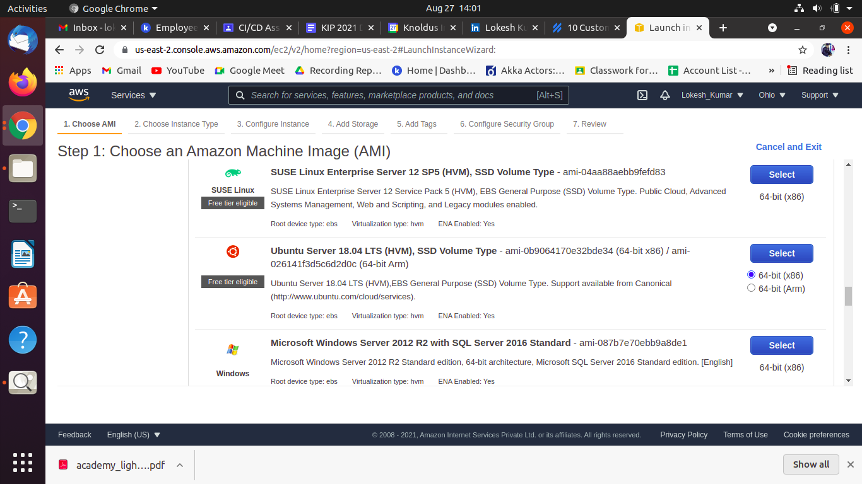

Slide 7
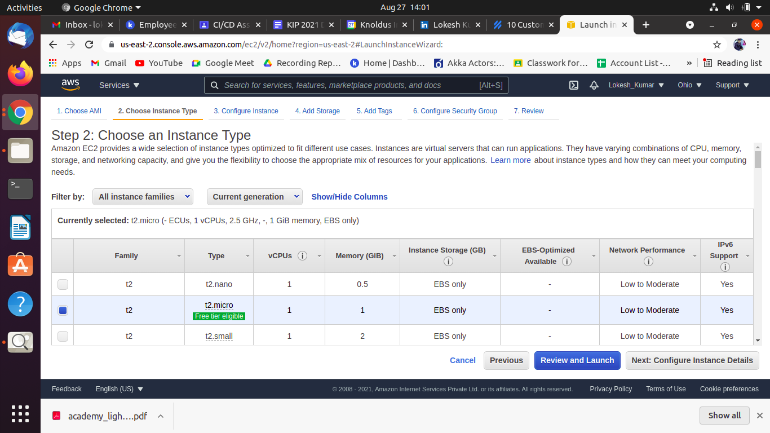

Slide 8
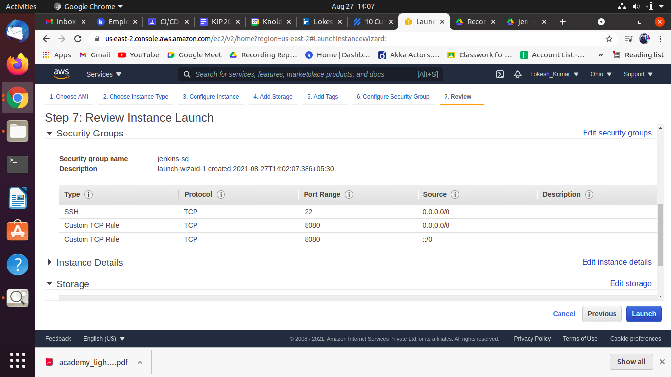
Step 2: create security role within instance

Slide 9
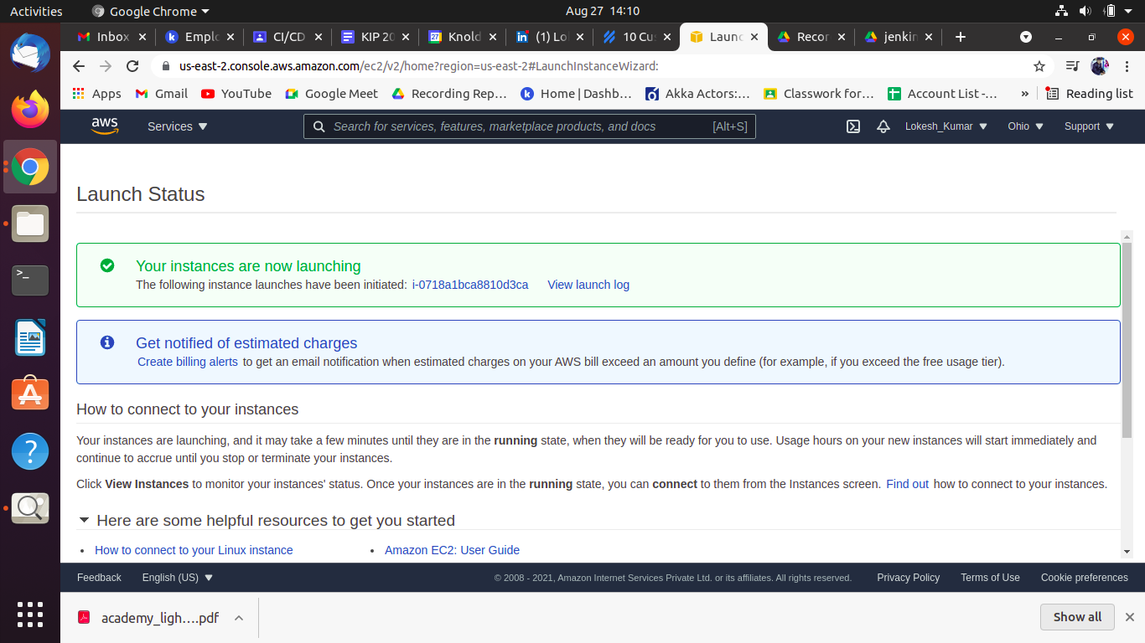

Slide 10
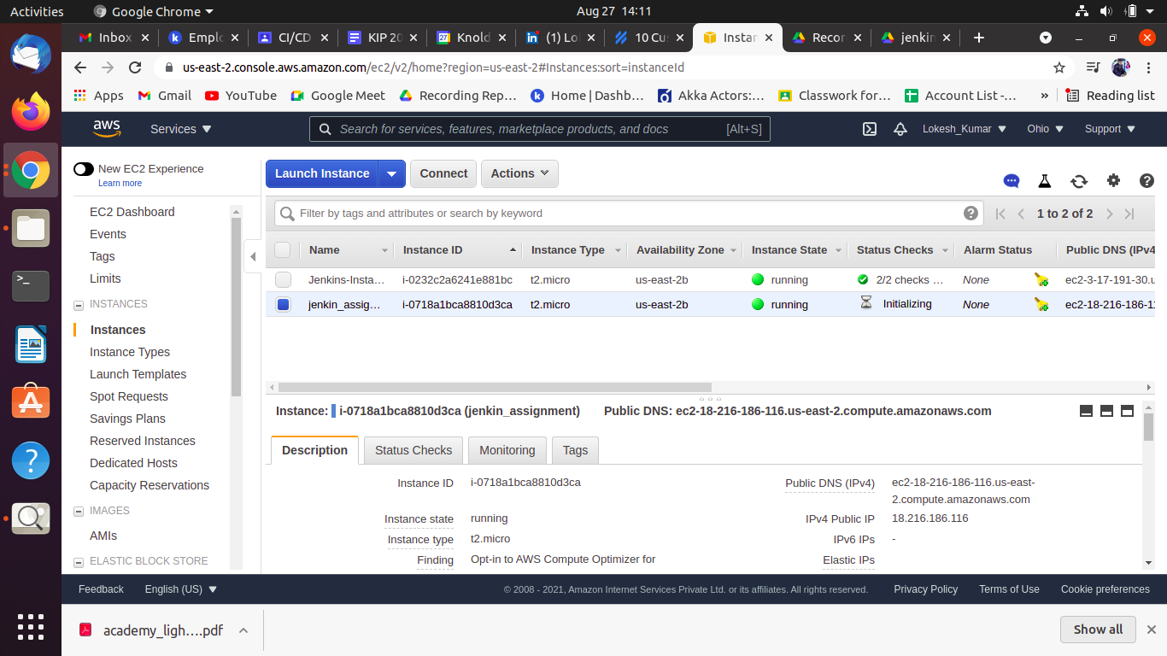

Slide 11
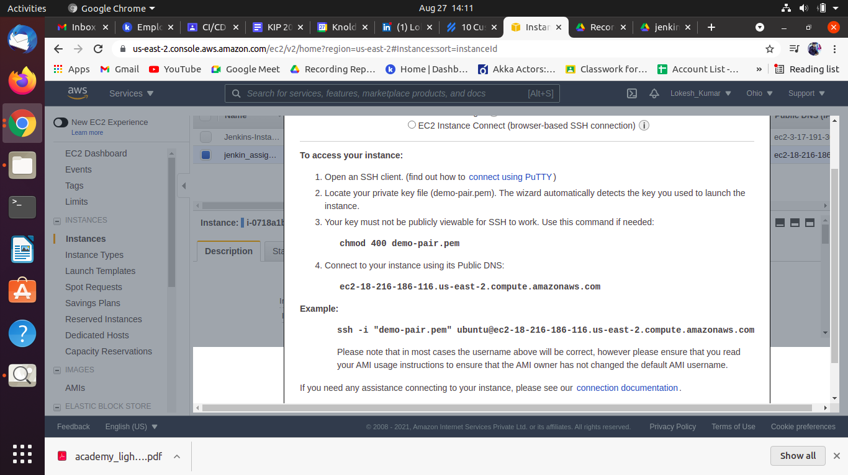

Slide 12
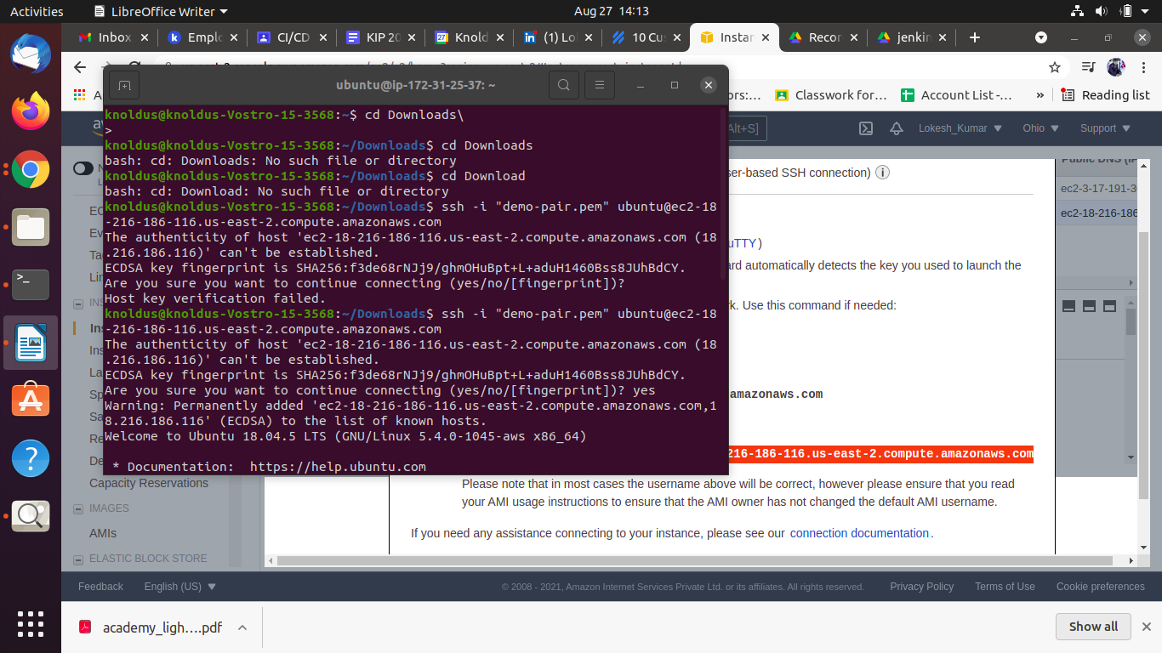
Step 3: Connect the terminal with Instance

Slide 13
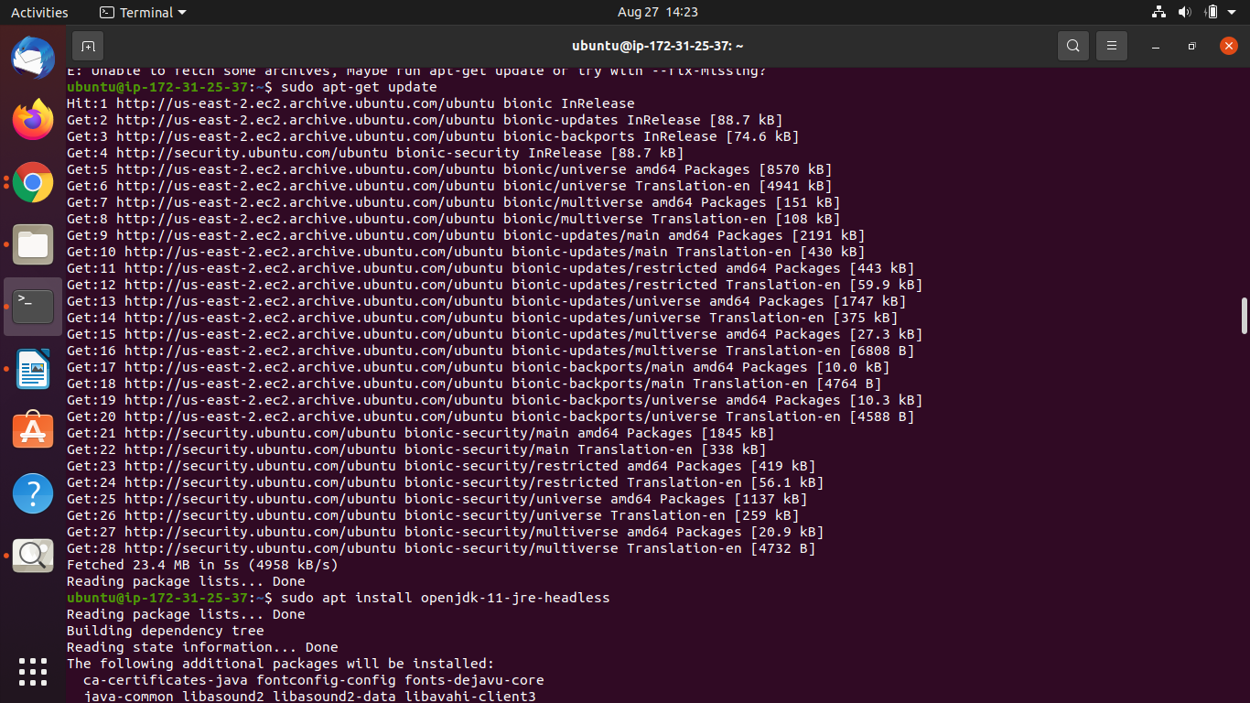
step 4: update the super user directory ( sudo )

Slide 14
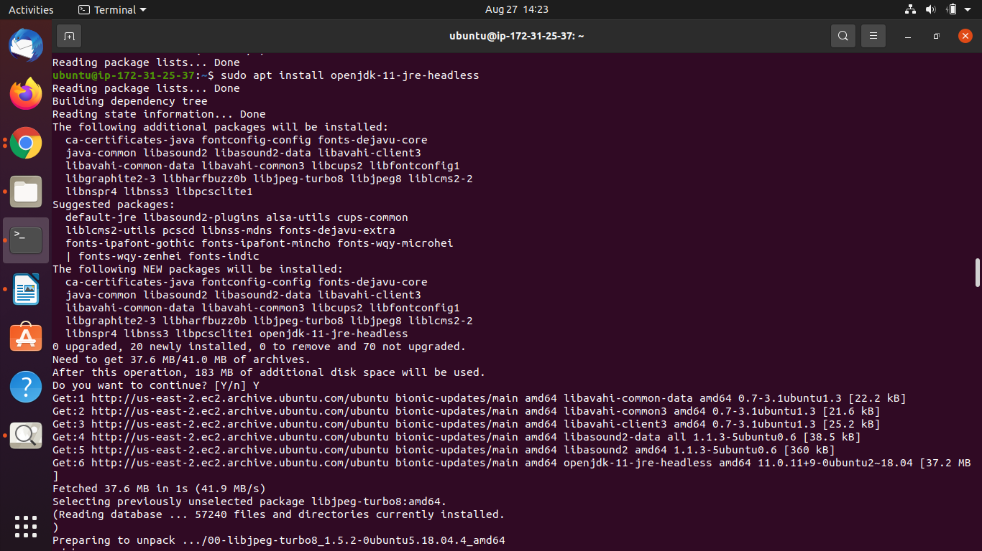
step 5: install jdk on remote instance

Slide 15
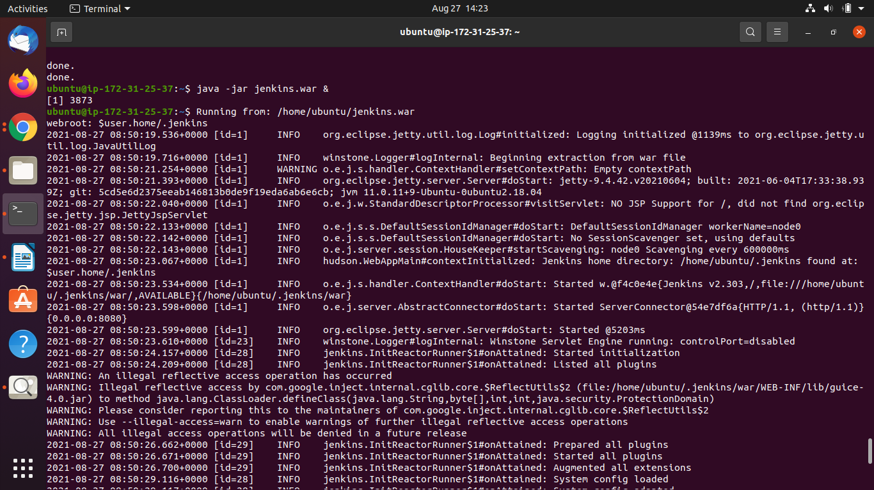
step 6: start jenkins

Slide 16
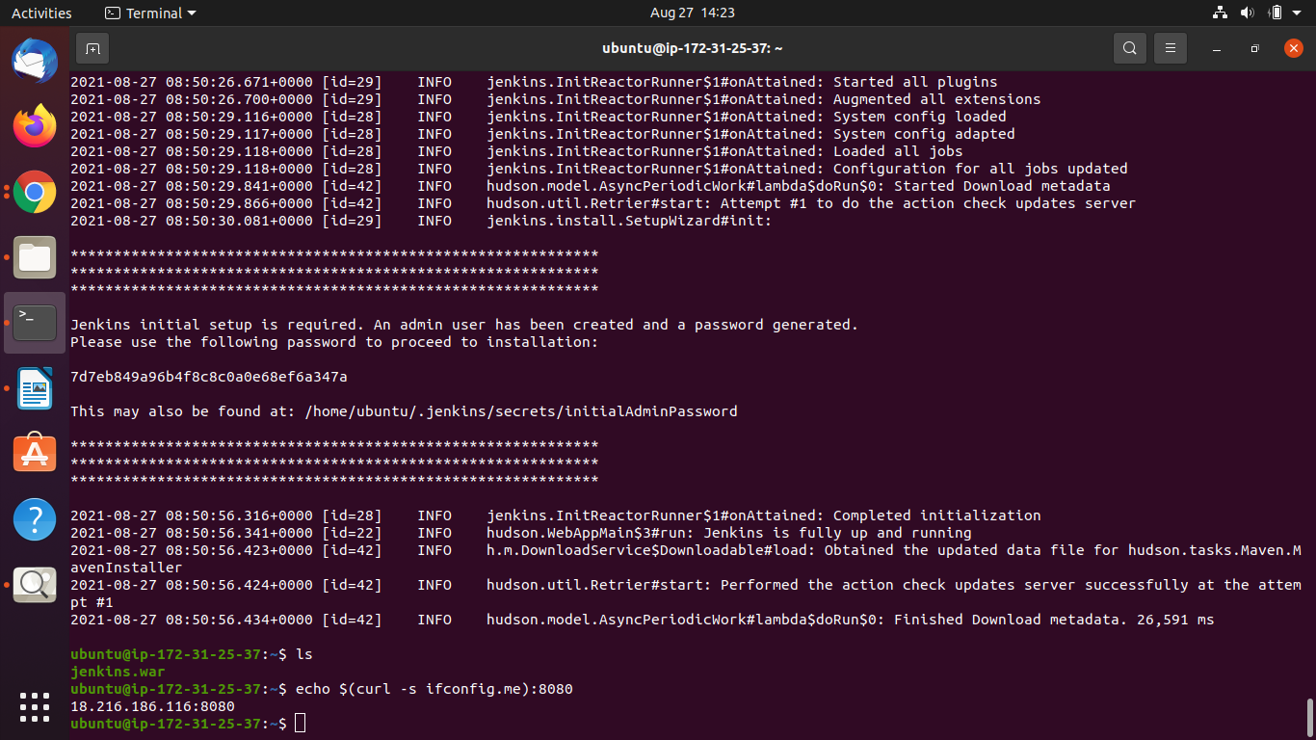

Slide 17
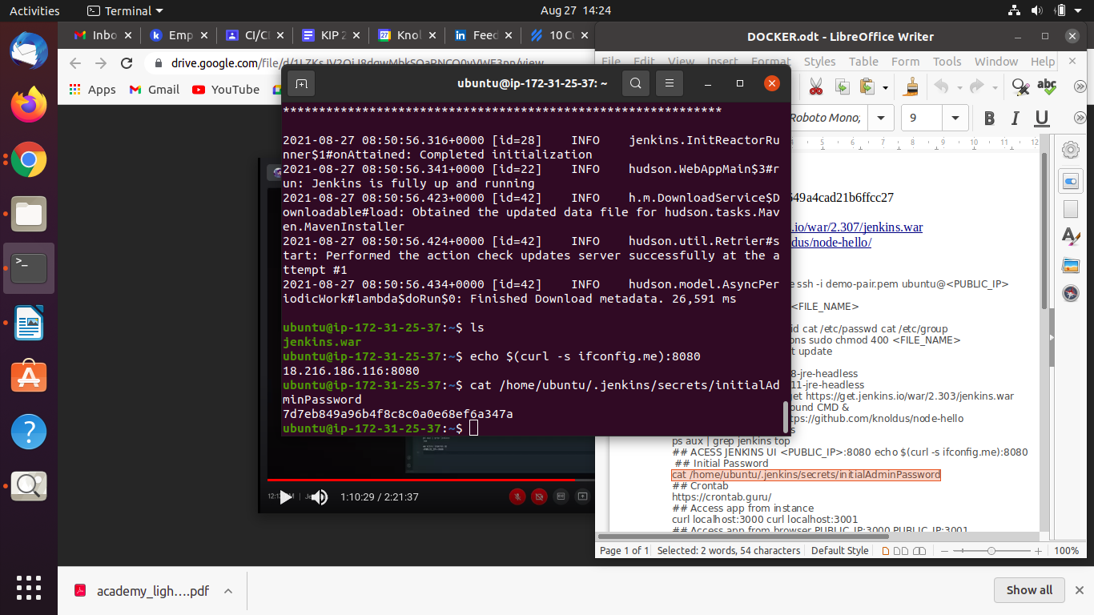

Slide 18
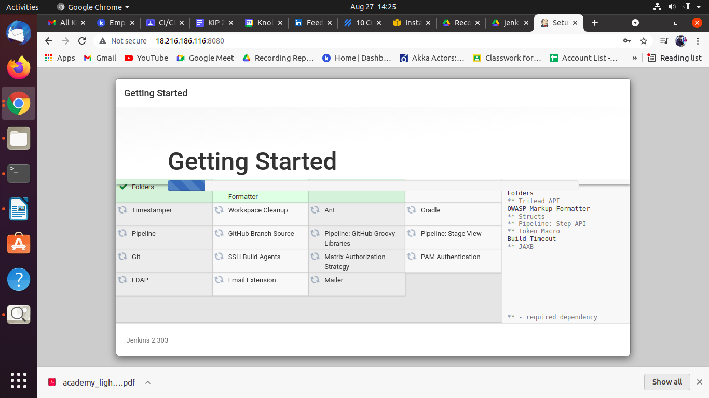

Slide 19
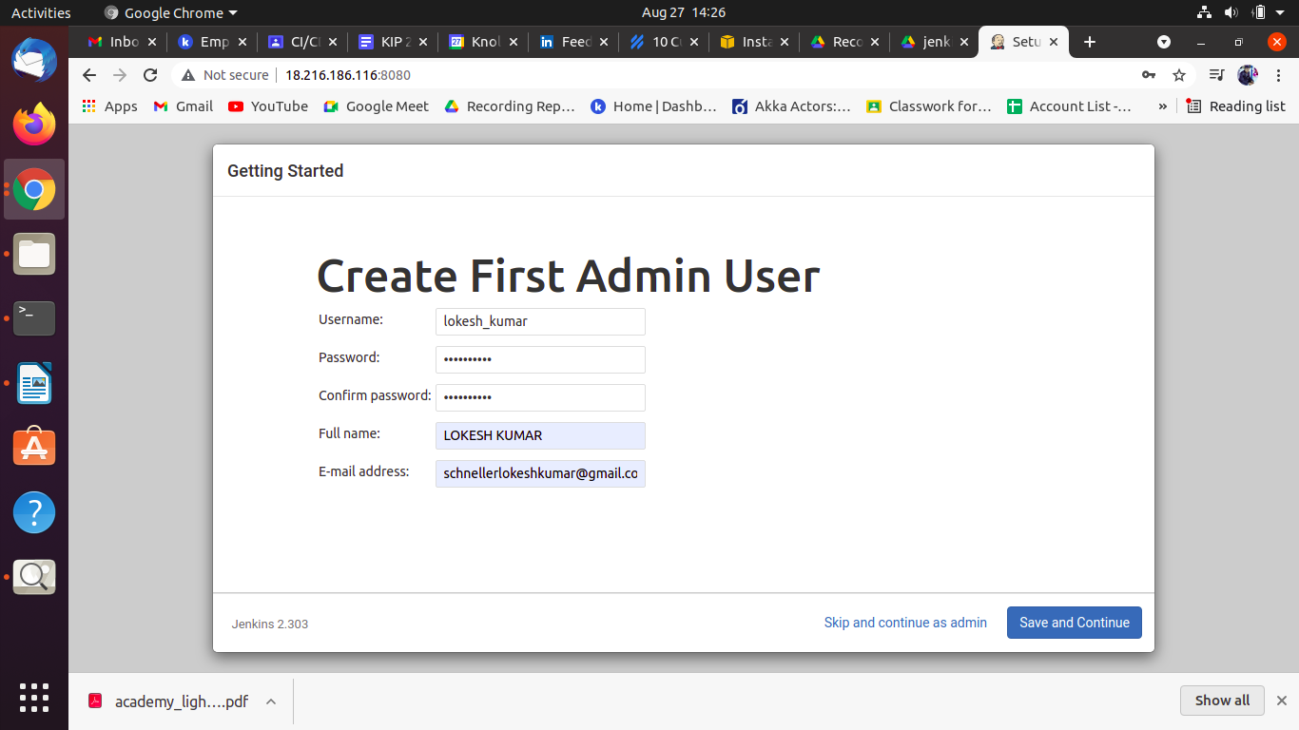
Step 7: Create admin credentials for jenkins

Slide 20
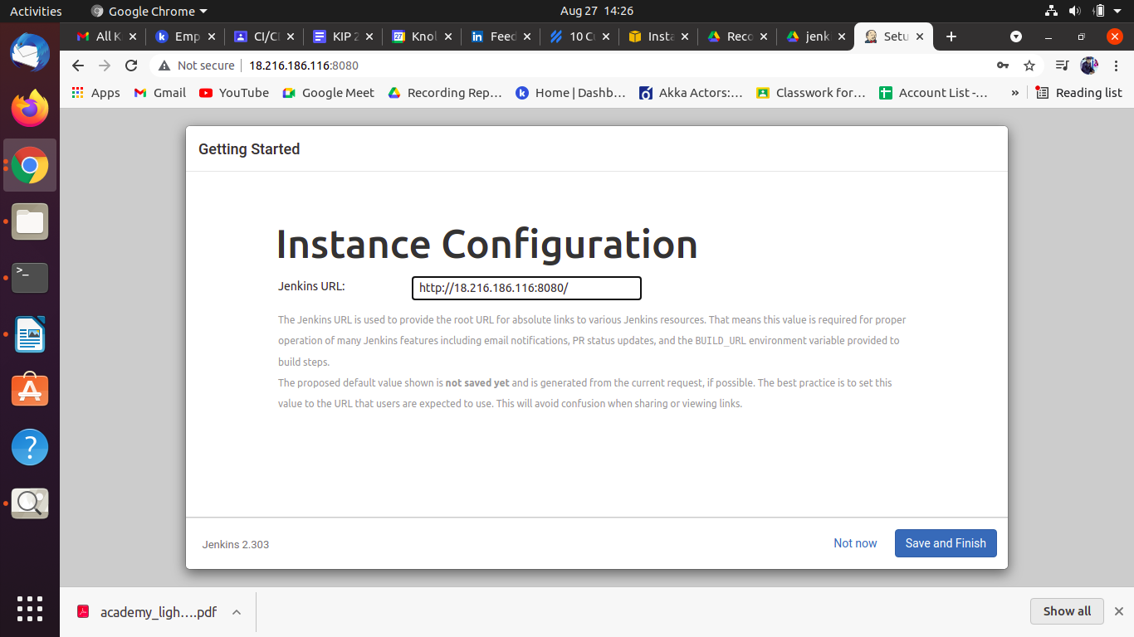

Slide 21
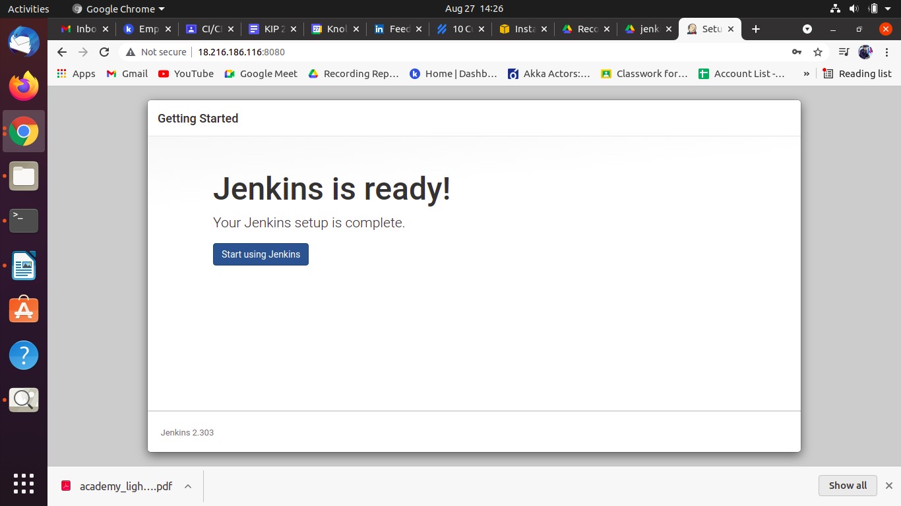

Slide 22
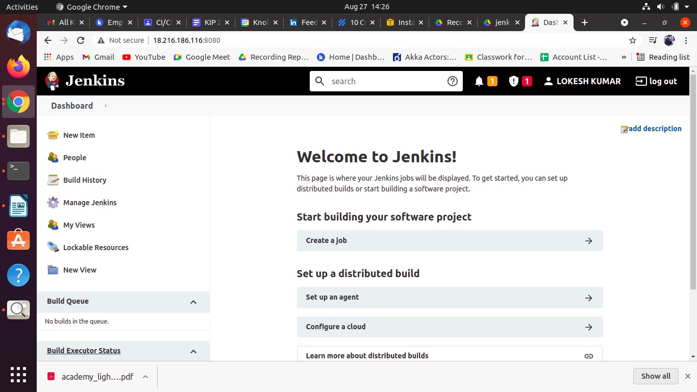
Step 8: login to jenkins

Slide 23
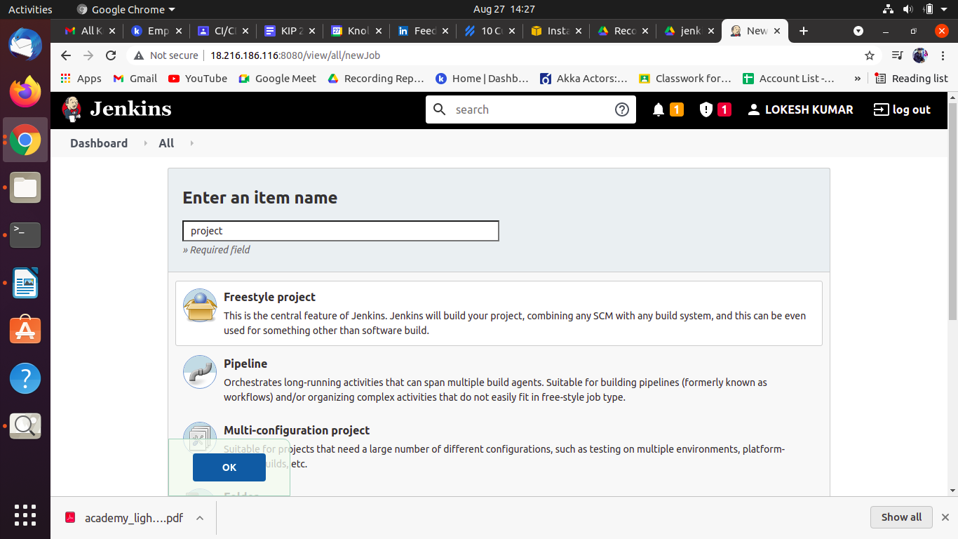
Step 9: Create a freestyle project

Slide 24
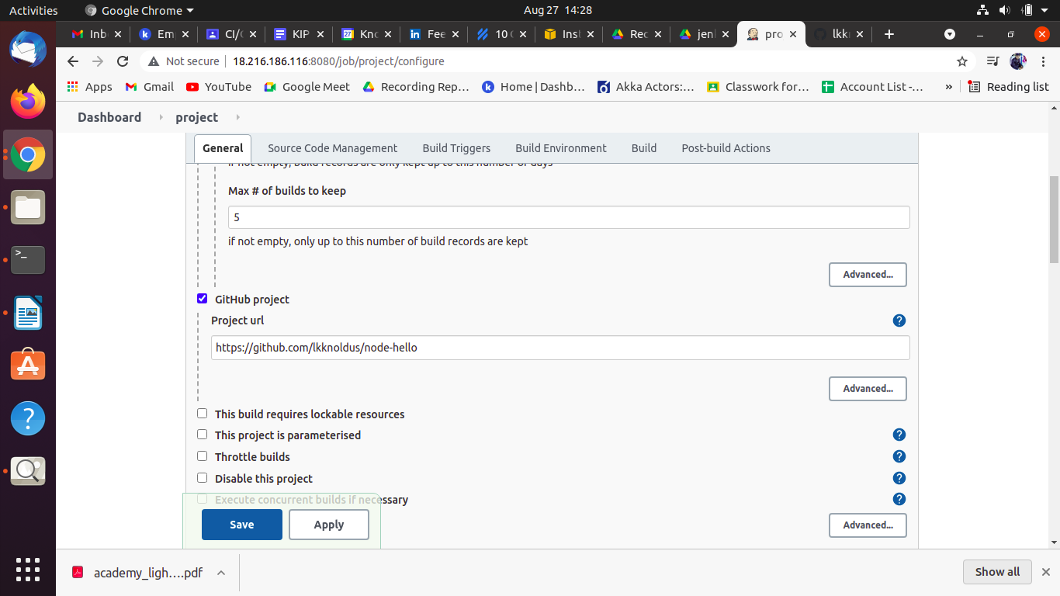
Step 10: configure all setting and apply

Slide 25
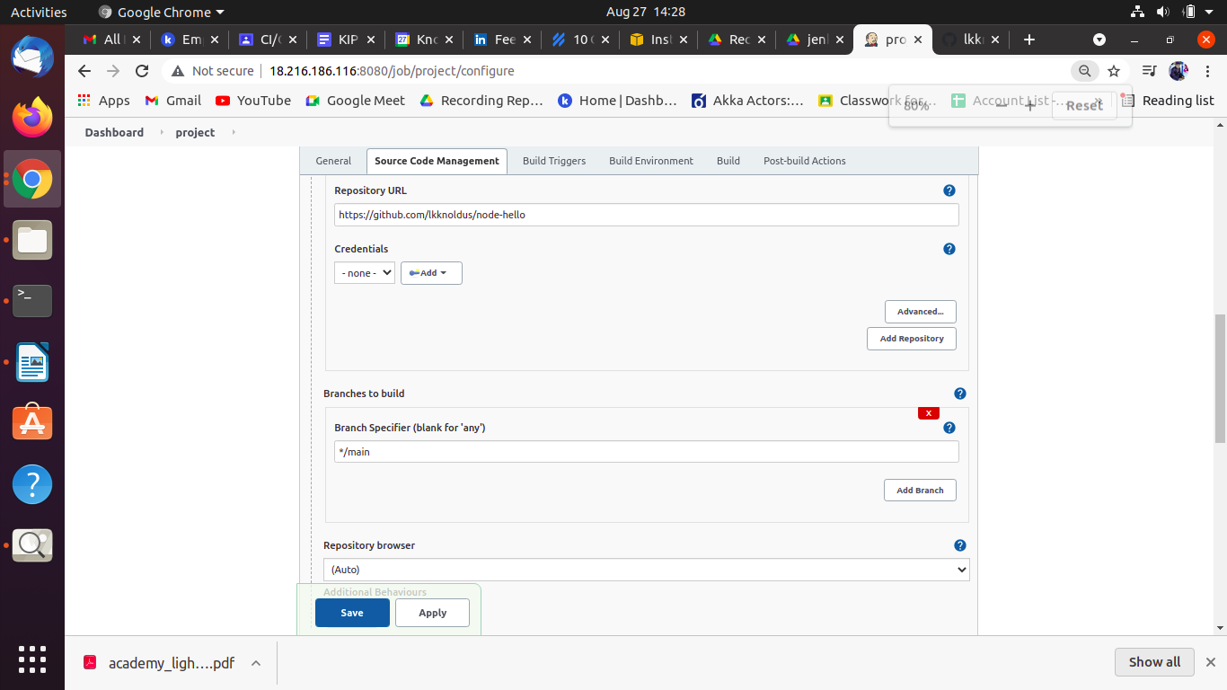

Slide 26
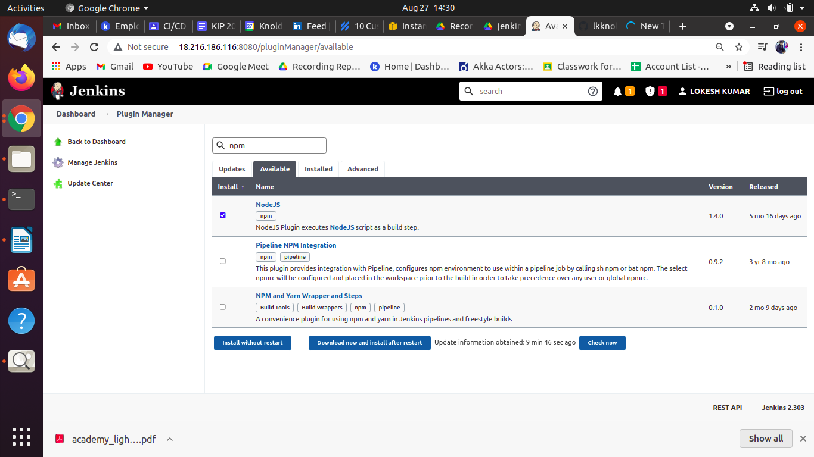
Step 11: Install all the required packages

Slide 27
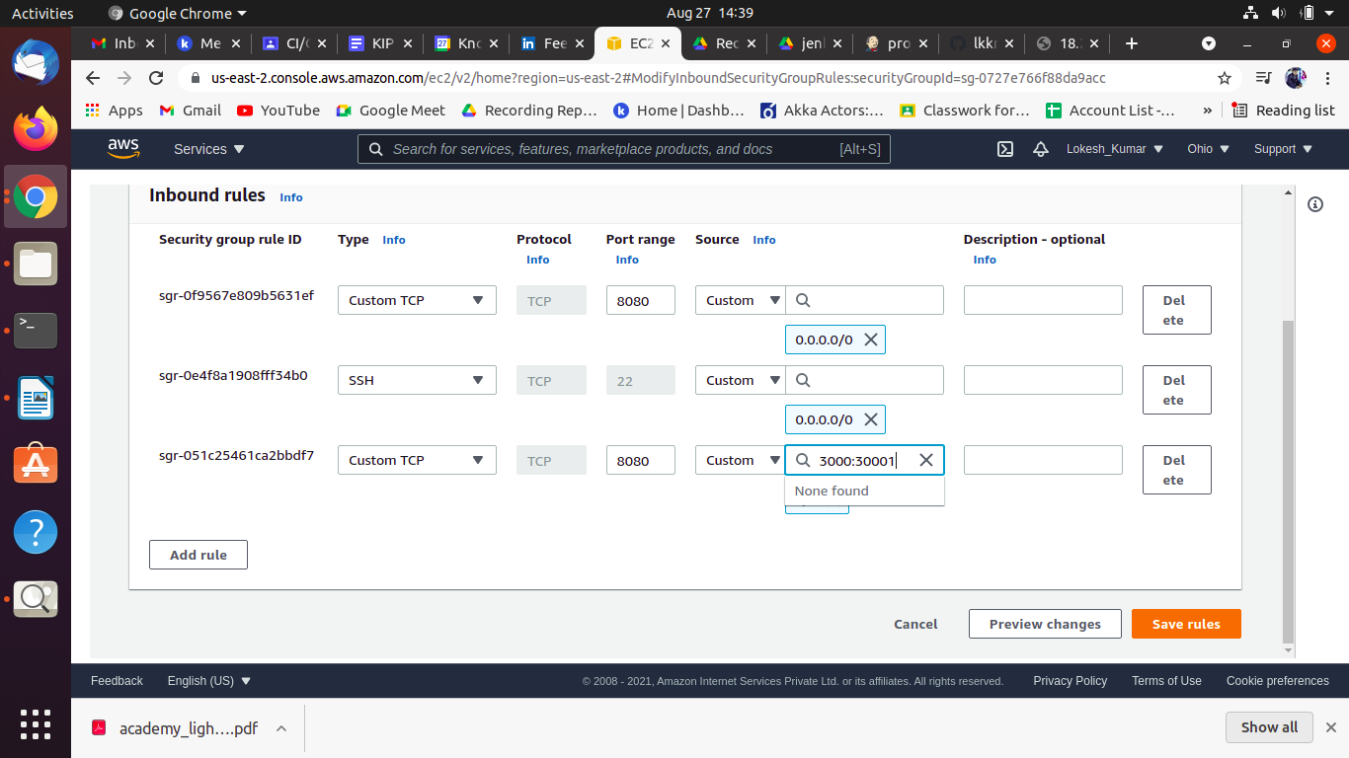
Step 12: Add inbound rule for 3000-3001 port

Slide 28
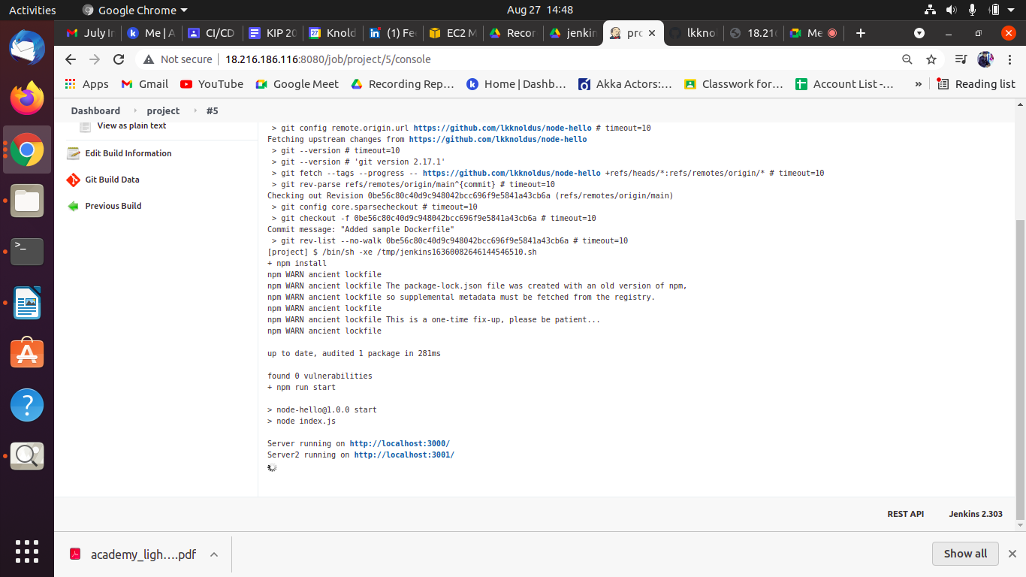
Step 13: Build the project

Slide 29
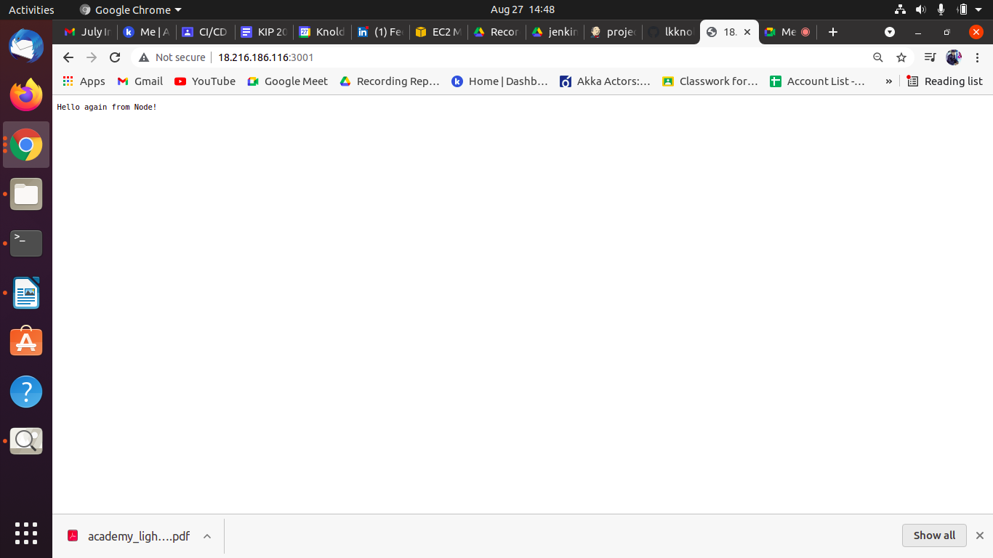
Step 14: Execute the final result at public IP
http://18.216.186.116:3001/

Slide 30

http://18.216.186.116:3000/

Slide 31
Thank You !
Get in touch with us:
Lorem Studio, Lord Building
D4456, LA, USA

